Slide 1
Gender Pay Gap Report
March 2023
Amanda Wood, Associate Director of Workforce
Dulani Liyanage, Senior Workforce Intelligence Analyst
March 2024

Slide 2
Message from Roland Sinker, Chief Executive Officer
I am pleased to share the sixth Gender Pay Gap report for Cambridge University Hospitals NHS Foundation Trust, which is one of the workforce information reports that enables the Trust to monitor diversity and informs decision making regarding workforce inequalities.
The workforce in CUH is predominantly female, which is in common with the wider NHS, and The Trust has a strong track record of recruiting internationally and promoting diversity within the workforce. It is important to recognise that inequalities do exist and positive action must be taken to address these inequalities. The Board has taken action to promote diversity in recruitment, which has resulted in additional female appointments to the Board.
Legislation has made it statutory for organisations with 250 or more employees to report annually on their gender pay gap. Government departments are covered by the Equality Act 2010 (Specific Duties and Public Authorities) Regulations 2017 which came into force on 31 March 2017. These regulations underpin the Public Sector Equality Duty and require the relevant organisations to publish their gender pay gap data each year by the 30 March, as at 31 March of the previous year.
This report sets out the information that the Trust is required to publish and some further information that has informed current action planning. The mean gender pay gap of 20.3% is largely unchanged over the past 5 years, however the median gender pay gap has increased by 10.1% over the past 5 years. The primary drivers of this gap are the high proportion of women in lower banded roles, a higher representation of men in the upper quartile and a higher number of male consultants than female consultants within the upper quartile.
The actions identified are included at the end of this report and we look forward to further detailed reviews that will explore this subject in greater detail, including further intersectional analysis of other protected characteristics and work to engage with staff and networks on this subject. The Trust will continue to build on the good progress already made in promoting diversity and equality within the workforce and living our values of Together – Safe, Kind and Excellent.
Gender Pay Gap Report, March 2023

Slide 3
Introduction
Our strategy - CUH Together incudes a priority to support our staff, with one of the five people priorities being inclusion - we will seek to drive out inequality, recognising that we are stronger when we value difference and inclusion.
Since the 31 March 2017, it has been a legal requirement for public sector organisations with more than 250 employees to report annually on their gender pay gap. The report must include the mean and median gender pay gaps; the mean and median gender bonus gaps; the proportion of men and women who received bonuses; and the proportions of male and female employees in each pay quartile. The definitions set out in the Equality Act 2010 (Specific Duties and Public Authorities) Regulations 2017 and NHS Employers guidance of the definitions of ordinary and bonus pay have been following in preparing this report.
The gender pay gap shows the difference in the average pay between all men and women in a workforce. The gender pay gap is different to equal pay. Equal pay deals with the pay differences between men and women who carry out the same or similar jobs or for work of equal value. It is unlawful to pay people unequally on the basis of gender. It is possible to have pay equality but still have a significant gender pay gap.
The Trust is committed to advancing equality of opportunity, regardless of sex, race, religion or belief, age, marriage or civil partnership, pregnancy/maternity, sexual orientation, gender reassignment or disability. On this basis, the Trust has a clear policy of paying employees equally for the same or equivalent work, regardless of their sex (or any other characteristic set out above). The Trust has a largely female workforce, like many other NHS organisations, with 73% of the workforce being female, and 27% male.
CUH is committed to this annual review and seeks to continuously learn from the findings and take action to reduce pay disparities.
Gender Pay Gap Report, March 2023

Slide 4
Definitions and Scope
There are six measures that must be included in a gender pay report. These are:
The mean gender pay gap
The median gender pay gap
The mean gender bonus gap
The median gender bonus gap
The proportions of men and women who received a bonus
The proportions of men and women in each quartile pay bands.
The gender pay gap is defined as the difference between the mean or median hourly rate of pay that male and female colleagues receive. The mean pay gap is the difference between average hourly earnings of men and women, i.e. the hourly gap divided by the average for men equates to the mean gender pay gap. The median pay gap is the difference between the midpoints in the ranges of hourly earnings of men and women. It takes all salaries in the sample, lines them up in order from lowest to highest, and picks the middle-most salary.
The report is based on rates of pay as at 31 March 2023 and bonuses paid in the year 1 April 2022 – 31 March 2023. It includes all workers in scope at 31 March 2023. Staff employed under a contract of employment including those under Agenda for Change terms and conditions, medical staff, and senior managers.
Only staff employed by the Trust at the snapshot date of 31 March 2023 are included in this report. This includes the Trust’s bank staff. Staff working in a hosted organisation (eg Cambridge University Health Partners), but employed by CUH are included in this report. Any contractors are not included. All data is taken from the Electronic Staff Record system.
Gender Pay Gap Report, March 2023

Slide 5
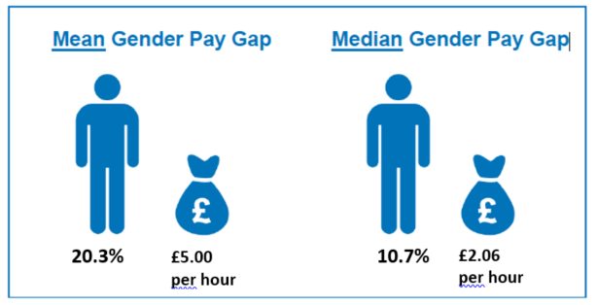
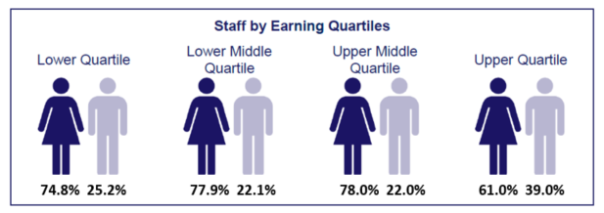
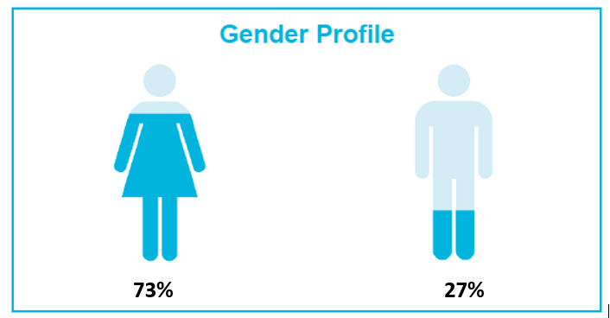
CUH Gender Pay Gap and Pay Quartiles by Gender
At CUH, there is a mean gender pay gap of 20.3%, and a median gender pay gap of 10.7% in favour of men. The Staff Earnings by Quartiles helps explain this gap further. It highlights that in the lowest quartile there is a small over representation of women by 1.8%. In the lower middle and upper middle quartiles, this over-representation is increased by 4.9% and 5% respectively. In the upper quartile women are under represented by approximately 12%. The Trust employ significantly more women than men in every category.
Gender Pay Gap Report, March 2023

Slide 6
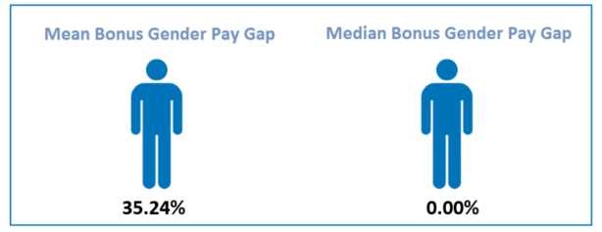
Bonus Pay – Gender Pay Gap Bonus Pay
Within the Gender pay Gap Regulations, ‘bonus pay’ means any remuneration that is in the form of money relating to profit sharing, productivity, performance, incentive or commission. For Bonus Pay, all staff are included that were employed as at the snapshot date. The regulations set out that bonus pay does not include ordinary pay, overtime pay, redundancy pay or termination payments. Waiting list initiatives have been considered in as overtime pay and are therefore excluded.
For the purpose of Ethnicity Pay Reporting, at CUH only medical consultants are in receipt of bonus payments. Clinical Excellence Awards (CEAs) payments are regarded as ‘bonus pay’. The Clinical Excellence Awards (CEA) scheme has changed over recent years. The same payment is given to all of those eligible, regardless of the hours that they work. This action may have helped to reduce the gap in bonus pay. Existing local CEA holders have been able to retain their historical awards and it is likely award holders will be able to retain these until retirement. National Clinical Impact Awards are decided outside of CUH, and are indented to recognise personal contributions towards the delivery of safe and high quality care to patients and to the continuous improvement of the NHS
Gender | Employees Paid Bonus | Total Employees | % Receiving Bonus
Female | 277 | 526 | 52.66%
Male | 362 | 755 | 47.95%
Gender Pay Gap Report, March 2023

Slide 7
Understanding the Gender Pay Gap – further analysis
In addition to the statutory requirements, the Trust has also undertaken analysis of the gender pay gap by band. In bands 5-8c, Career Grade, Senior Managers and Apprentice, there is pay gap in favour of women.
Apprentice | Band 5 | Band 6 | Band 7 | Band 8A | Band 8B | Band 8C | Career Grade | Senior Manager
5.1% | 1.5% | 1.3% | 1.2% | 2.2% | 1.1% | 2.2% | 3.6% | 3.5%
£0.36 p/h | £0.26 p/h | £0.25 p/h | £0.42 p/h | £0.29 p/h | £0.33 p/h | £0.79 p/h | £1.12 p/h | £2.05ph
On a mean average, women earn more in these pay bands than men
In pay bands 2-4, 8d, 9, Consultants, and Doctors in Training, men earn more than their female counterparts.
Band 2 | Band 3 | Band 4 | Band 8D | Band 9 | Consultants | Drs in training
1.6% | 2.2% | 2.4% | 2.4% | 1.6% | 5.5% | 7.1%
£0.20 p/h | £0.27 p/h | £0.32 p/h | £1.08 p/h | £0.87 p/h | £3.07 p/h | £2.12 p/h
On a mean average, men earn more in these pay bands than women
Gender Pay Gap Report, March 2023

Slide 8
Comparison to Previous Year
Change in the Mean Average Hourly Rates of Pay and Gender Pay Gap
Gender | 2022 Mean Hourly Rate | 2023 Mean Hourly Rate | Chance Since Previous Year
Male | 23.54 | 24.69 | £1.15
Female | 18.79 | 19.69 | £0.90
Difference | 4.75 | 5.00 | £0.25
Pay Gap % | 20.2% | 20.3% | 0.1%
The mean average gender pay gap has increased by 0.1% since 31st March 2022.
The mean average hourly rate for male staff has increased by £1.15, for female staff the increase has been £0.90.
Change in the Median Average Hourly Rates of Pay and Gender Pay Gap
Gender | 2022 Mean Hourly Rate | 2023 Mean Hourly Rate | Chance Since Previous Year
Male | 18.56 | 19.30 | £0.74
Female | 16.52 | 17.24 | £0.72
Difference | 2.04 | 2.06 | £0.02
Pay Gap % | 11.0% | 10.7% | -0.3%
The median average gender pay gap has decreased by 0.3% since 31st March 2022 to 10.7%.
The median average hourly rate for female staff has increased by £0.72 whereas the median hourly rate for male staff has increased by £0.74.
Gender Pay Gap Report, March 2023

Slide 9
Mean & Median Pay Gap – by Ethnicity & Gender
Mean Intersectional Pay Gaps: Gender and Ethnicity (2023)
Male
Female
Ethnicity | Mean Avg. Hourly Rate | Pay Gap vs White Male
1. White | 25.17 | -
2. Ethnic Minorities | 23.81 | 5.4%
3. Not stated / Blank | 25.49 | -1.3%
Ethnicity | Mean Avg. Hourly Rate | Pay Gap vs White Male
1. White | 19.93 | 20.8%
2. Ethnic Minorities | 19.00 | 24.5%
3. Not stated / Blank | 20.39 | 19.0%
Median Intersectional Pay Gaps: Gender and Ethnicity (2023)
Male
Female
Ethnicity | Mean Avg. Hourly Rate | Pay Gap vs White Male
1. White | 20.11 | -
2. Ethnic Minorities | 18.48 | 8.1%
3. Not stated / Blank | 20.75 | -3.2%
Ethnicity | Mean Avg. Hourly Rate | Pay Gap vs White Male
1. White | 17.30 | 14.0%
2. Ethnic Minorities | 17.07 | 15.1%
3. Not stated / Blank | 18.01 | 10.4%
When considering the intersection between gender and ethnicity, the tables opposite and the chart below illustrate that on average females from an ethnic minority background receive lower pay than their male colleagues, who are also from an ethnic minority background. On average, both males and females from an ethnic minority background receive a lower hourly rate compared to white males.
This is pattern is the same when considering both the mean and the median pay gap.
Ethnicity Pay Gap Report- March 2023

Slide 10
Mean and Median Pay Gap – Historic Data
Gender | Mean 2017 | Median 2017 | Mean 2018 | Median 2018 | Mean 2019 | Median 2019 | Mean 2020 | Median 2020 | Mean 2021 | Median 2021 | Mean 2022 | Median 2022 | Mean 2023 | Median 2023
Male | 20.42 | 14.89 | 20.33 | 14.79 | 20.83 | 15.18 | 21.71 | 16.36 | 22.65 | 17.38 | 23.54 | 18.56 | 24.69 | 19.30
Female | 15.86 | 14.39 | 16.26 | 14.70 | 16.63 | 14.69 | 17.40 | 15.51 | 18.00 | 16.04 | 18.79 | 16.52 | 19.69 | 17.24
Difference | 4.56 | 0.50 | 4.07 | 0.08 | 4.20 | 0.49 | 4.31 | 0.85 | 4.66 | 1.34 | 4.75 | 2.04 | 5.00 | 2.06
Pay Gap % | 22.3% | 3.4% | 20.0% | 0.6% | 20.2% | 3.2% | 19.9% | 5.2% | 20.6% | 7.7% | 20.2% | 11.0% | 20.3% | 10.7%
Gender Pay Gap Report, March 2023

Slide 11
Reducing the Gender Pay Gap
The Trust welcomes the opportunity to publish the sixth CUH Gender Pay gap report. CUH has a mean gender pay gap of 20.3% and median gender pay gap of 10.7%. The primary drivers of this gap are the high proportion of women in the lowest 3 quartiles, a higher representation of men in the upper quartile and a higher number of male consultants than female consultants within the upper quartile. The Trust is committed to advancing equality of opportunity within the workforce and on this basis, has identified a number of actions to take forward:
Further intersectional analysis of pay gaps, and pay gaps across functions and roles to understand the relationships across protected characteristics and engage staff networks on this subject to identify further positive action.
Engage staff networks in the review of pay gap data and develop practical actions from these conversations and feedback.
Continue to actively support women to return to work following maternity and adoption leave and offer shared parental leave and flexible working arrangements.
Continue to scrutinise Board diversity as noted in the Workforce Race Equality Standard (WRES) action plan and ensure executive search organisations provide assurance regarding diversity.
Gender Pay Gap Report, March 2023

