Slide 1
Ethnicity Pay Gap Report
March 2023
Amanda Wood, Associate Director of Workforce
Dulani Liyanage, Senior Workforce Intelligence Analyst
March 2024

Slide 2
Message from Roland Sinker, Chief Executive Officer
I am pleased to share the second Ethnicity Pay Gap report for Cambridge University Hospitals NHS Foundation Trust, which is an addition to the workforce information that enables the Trust to monitor diversity and inform decision making regarding workforce inequalities. Voluntarily publishing this report illustrates our commitment to transparency, fairness and inclusion to all of our staff, patients and the wider community.
At the end of March 2023, there was a mean ethnicity pay gap of 2.9%, and a median ethnicity pay gap of 4.1% in favour of those reporting as white. When looking further we can see that in all pay bands above band 8b or over a salary of £56,000 there is a pay gap in favour of staff reporting as white. When considering the ethnicity pay gap over time, there is a gradual change from a pay gap of 4.7% in favour of ethnic minority staff in 2017 to a 4.1% pay gap of in favour of those reporting as white in 2023. This trend is concerning and reflects an increasing proportion of ethnic minority staff over the same time frame. Data regarding the intersection between gender and ethnicity has been included in this report for the first time. Further consideration of available pay data is required to fully understand the drivers.
Actions are identified at the end of this report, which are aligned to our Workforce Race Equality Standard (WRES) agenda, inclusive of the Race Disparity Ratio and our Model Employer targets. I look forward to further detailed reviews that will explore this subject in greater detail, including further intersectional analysis of other protected characteristics, analysis of data relating to specific ethnic groups and further work to engage with staff and our networks on this subject to understand experience.
The Trust will continue to build on the good progress already made in promoting diversity and equality within the workforce and living our values of Together – Safe, Kind and Excellent.
Ethnicity Pay Gap Report- March 2023

Slide 3
Introduction
Our strategy - CUH Together incudes a priority to support our staff, with one of the five people priorities being inclusion - we will seek to drive out inequality, recognising that we are stronger when we value difference and inclusion.
In 2017 the UK government published the first report to examine the barriers people from ethnic minorities face in employment, named Race in the workplace. Their report highlighted the need to first be able to measure the disadvantage some ethnic groups face in order to address the barriers to earning as much as their white colleagues.
In 2018, the Race Disparity Unit and CIPD led the call for the introduction of ethnicity pay gap reporting in “Our Manifesto for Work”. This led to the government consultation on whether to introduce mandatory ethnicity pay gap reporting, which ran from October 2018 to January 2019. The Women and Equalities Committee published a report calling for the Government to implement mandatory reporting of ethnicity pay by April 2023, however the Government has confirmed they will not be legislating at this time.
CUH is voluntarily and proactively producing an ethnicity pay gap report as part of our approach to improve inclusion and create a fair workplace. In the absence of a mandatory framework for ethnic pay gap reporting, the Trust has aligned with the approach in place for gender pay gap reporting to highlight any inequalities. The Trust is committed to advancing equality of opportunity, regardless of sex, race, religion or belief, age, marriage or civil partnership, pregnancy/maternity, sexual orientation, gender reassignment or disability. On this basis, the Trust has a clear policy of paying employees equally for the same or equivalent work, regardless of their ethnicity (or any other characteristic set out above). The Trust has a largely White workforce, like many other NHS organisations, with 65% of the workforce reporting as white, and 30% reporting to be ethnically diverse.
A benchmarking report published by PwC in 2021 highlights that a high level analysis of the ethnicity pay gap can mask disadvantage for specific ethnic groups. We plan to build on our work on ethnicity pay gaps to include further analysis of individual ethnic groups including to identify any disparities amongst the White ethnicity groups.
Ethnicity Pay Gap Report- March 2023

Slide 4
Definitions and Scope
The reference group to measure the ethnicity pay gap are those staff who have reported as White or White British. There are six measures that have been included in the ethnicity pay report, which aligns with the Gender Pay Gap report for CUH. These are:
• The mean ethnicity pay gap
• The median ethnicity pay gap
• The mean ethnicity bonus gap
• The median ethnicity bonus gap
• The proportions of white and ethnic minority groups who received a bonus
• The proportions of white and ethnic minority in each quartile pay bands.
The ethnicity pay gap is defined as the difference between the mean or median hourly rate of pay that white and ethnic minority colleagues receive.
The mean pay ethnicity gap is the difference between average hourly earnings of white and ethnic minority groups, i.e. the hourly gap divided by the average for white colleagues equates to the mean ethnicity pay gap.
The median pay gap is the difference between the midpoints in the ranges of hourly earnings of white and ethnic minority staff. It takes all salaries in the sample, lines them up in order from lowest to highest, and picks the middle-most salary.
The report is based on rates of pay as at 31 March 2023 and bonuses paid in the year 1 April 2022 – 31 March 2023. It includes all workers in scope at 31 March 2023. Staff employed under a contract of employment including those under Agenda for Change terms and conditions, medical staff, and senior managers. Only staff employed by the Trust at the snapshot date of 31 March 2023 are included in this report.
This includes the Trust’s bank staff. Staff working in a hosted organisation (eg Cambridge University Health Partners), but employed by CUH are included in this report. Any contractors are not included. All data is taken from the Electronic Staff Record system.
Ethnicity Pay Gap Report- March 2023

Slide 5
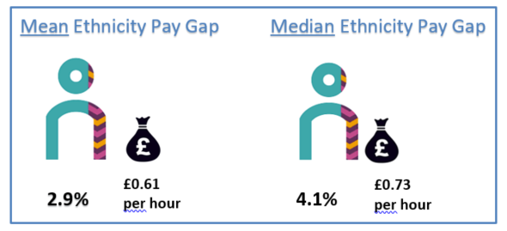
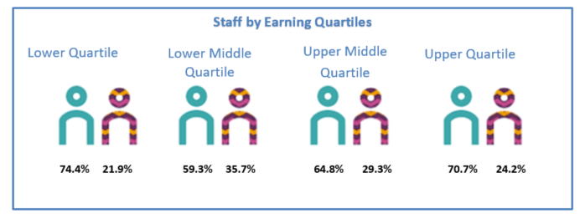
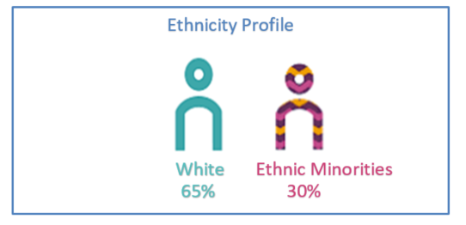
CUH Ethnicity Pay Gap and Pay Quartiles by Ethnicity
At CUH, there is a mean ethnicity pay gap of 2.9%, and a median ethnicity pay gap of 4.1% in favour of those reporting as white. The Staff Earnings by Quartiles helps to explain the gap against the overall CUH ethnicity profile. In the lowest quartile, there is approximately a 7% difference, the lower middle quartile has an 8% difference, the upper middle quartile has a 2% difference and the upper quartile has a 4% difference. The Trust employ significantly more staff reporting as White or White British than ethnic minority groups in each quartile.
Ethnicity Pay Gap Report, March 2023

Slide 6
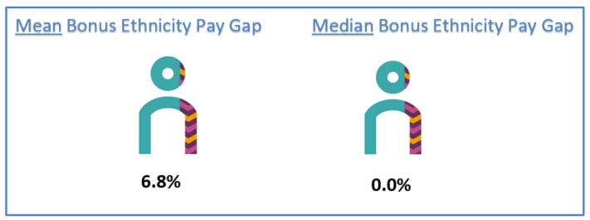
Bonus Pay – Ethnicity Pay Gap Bonus Pay
Within the Ethnicity pay Gap Regulations, ‘bonus pay’ means any remuneration that is in the form of money relating to profit sharing, productivity, performance, incentive or commission. For Bonus Pay, all staff are included that were employed as at the snapshot date. The regulations set out that bonus pay does not include ordinary pay, overtime pay, redundancy pay or termination payments. Waiting list initiatives have been considered in as overtime pay and are therefore excluded.
For the purpose of Ethnicity Pay Reporting, at CUH only medical consultants are in receipt of bonus payments. Clinical Excellence Awards (CEAs) payments are regarded as ‘bonus pay’. The Clinical Excellence Awards (CEA) scheme has changed over recent years. The same payment is given to all of those eligible, regardless of the hours that they work. This action may have helped to reduce the gap in bonus pay. Existing local CEA holders have been able to retain their historical awards and it is likely award holders will be able to retain these until retirement. National Clinical Impact Awards are decided outside of CUH and are intended to recognise personal contributions towards the delivery of safe and high-quality care to patients and to the continuous improvement of the NHS.
Ethnicity | Employees Paid Bonus | Total Employees | % Receiving Bonus
1. White | 429 | 694 | 61.82%
2. BME | 185 | 266 | 69.55%
3. Not stated/Blank | 25 | 321 | 7.79%
Ethnicity Pay Gap Report- March 2023

Slide 7
Understanding the Ethnicity Pay Gap – further analysis
Below is the ethnicity pay gap by band. In bands 2,3,5,6, 8A,Doctor in training and Apprentices there is pay gap in favour of minority ethnic staff.
Apprentice | Band 2 | Band 3 | Band 5 | Band 6 | Band 8A | Drs in training
6.85% | 4.0% | 0.5% | 3.0% | 0.1% | 0.9% | 1.4%
£0.16 p/h | £0.47 p/h | £0.07 p/h | £0.49 p/h | £0.02 p/h | £0.25 p/h | £0.39 p/h
In pay bands 4,7, 8b-9, Career Grade, Consultants and Senior Manager, there is a pay gap in favour of staff reporting as white.
Band 4 | Band 7 | Band 8B | Band 8C | Band 8D | Band 9 | Career Grade | Consultants | Senior Manager
2.4% | 0.7% | 0.7% | 5.0% | 7.2% | 8.00% | 13.3% | 4.5% | 88.4%
£0.31 p/h | £0.17 p/h | £0.21 p/h | £1.83 p/h | £3.14 p/h | £4.25 p/h | £4.55 p/h | £2.52 p/h | £54.60ph
Ethnicity Pay Gap Report- March 2023

Slide 8
Comparison to the previous Year
Change in the Mean Average Hourly Rates of Pay and Ethnicity Pay Gap
Ethnicity | 2022 Mean Hourly Rate | 2023 Mean Hourly Rate | Chance Since Previous Year
White | 20.15 | 21.20 | £1.05
BME | 19.81 | 20.59 | £0.78
Difference | 0.34 | 0.61 | £0.27
Pay Gap % | 1.7% | 2.9% | 1.2%
The mean average Ethnicity pay gap has increased by 1.2% since 31st March 2022.
The mean average hourly rate for White staff has increased by £1.05, for BME staff the increase has been £0.78.
Change in the Median Average Hourly Rates of Pay and Ethnicity Pay Gap
Ethnicity | 2022 Median Hourly Rate | 2023 Median Hourly Rate | Chance Since Previous Year
White | 17.07 | 18.00 | £0.93
BME | 16.54 | 17.27 | £0.73
Difference | 0.53 | 0.73 | £0.20
Pay Gap % | 3.1% | 4.1% | 1.0%
The median average Ethnicity pay gap has decreased by 1.0% since 31st March 2022 to 4.1%.
The median average hourly rate for White staff has increased by £0.93 whereas the median hourly rate for BME staff has increased by £0.73.
Ethnicity Pay Gap Report- March 2023

Slide 9
Mean & Median Pay Gap – by Ethnicity & Gender
Mean Intersectional Pay Gaps: Gender and Ethnicity (2023)
Male
Female
Ethnicity | Mean Avg. Hourly Rate | Pay Gap vs White Male
1. White | 25.17 | -
2. Ethnic Minorities | 23.81 | 5.4%
3. Not stated / Blank | 25.49 | -1.3%
Ethnicity | Mean Avg. Hourly Rate | Pay Gap vs White Male
1. White | 19.93 | 20.8%
2. Ethnic Minorities | 19.00 | 24.5%
3. Not stated / Blank | 20.39 | 19.0%
Median Intersectional Pay Gaps: Gender and Ethnicity (2023)
Male
Female
Ethnicity | Mean Avg. Hourly Rate | Pay Gap vs White Male
1. White | 20.11 | -
2. Ethnic Minorities | 18.48 | 8.1%
3. Not stated / Blank | 20.75 | -3.2%
Ethnicity | Mean Avg. Hourly Rate | Pay Gap vs White Male
1. White | 17.30 | 14.0%
2. Ethnic Minorities | 17.07 | 15.1%
3. Not stated / Blank | 18.01 | 10.4%
When considering the intersection between gender and ethnicity, the tables opposite and the chart below illustrate that on average females from an ethnic minority background receive lower pay than their male colleagues, who are also from an ethnic minority background. On average, both males and females from an ethnic minority background receive a lower hourly rate compared to white males.
This is pattern is the same when considering both the mean and the median pay gap.
Ethnicity Pay Gap Report- March 2023

Slide 10
Mean & Median Pay Gap – Historic Data
When considering the ethnicity pay gap over time, there is a gradual change from a pay gap of 4.7% in favour of ethnic minority staff in 2017 to a 4.1% pay gap of in favour of those reporting as white in 2023. This trend is occurring as the proportion of ethnic minority staff employed at CUH is increasing over the same time frame.
Ethnicity Pay Gap Report- March 2023

Slide 11
Reducing the Ethnicity Pay Gap
This is the second CUH Ethnicity Pay gap report, which has been produced as part of CUH’s commitment to improve inclusion and create a fair workplace. CUH has a mean ethnicity pay gap of 2.9% and 4.1% median ethnicity pay gap. The primary drivers of this gap are the higher proportion of ethnic minority staff in lower banded roles, a higher representation of white staff in the upper quartile and medical workforce. When the ethnicity pay gap is reviewed over the position has become increasingly worse for ethnic minority staff since 2017. When considering the intersection with gender, the pay gap is increased further.
The Trust is committed to ensuring equity within the workforce and on this basis, has identified a number of actions to take forward which are aligned to actions identified in the WRES action plan:
• Undertake a deeper level of analysis of the available pay data to better understand the drivers and potential actions.
Inclusive talent management and clinical career progression to encourage development and opportunities across the workforce.
• Continue to promote the CUH Race Equality and Cultural Heritage network, and develop practical actions from network conversations and feedback.
• Developing inclusive leaders and managers, and providing education to support them in commitment to antiracism.
Ethnicity Pay Gap Report- March 2023

